Slide 1
AI for Good
Exploring How Generative AI Can Support Universal Design for Learning
Brenda McDermott (she/her)
bemcderm@ucalgary.ca

Slide 2

Mapping Today’s Discussion
Generative AI Foundations
Generative AI Panic or Ability Bias
Generative AI and Social Justice in Education
Generative AI for Universal Design for Learning
Image: L. Anselmo

Slide 3

Generative Artificial Intelligence isn’t Really Intelligence
Dall-E

Slide 4
Machine Learning Basics
Sample data
Training Examples
Large Language Model
Predictive Outputs
Notes:
ML is an application of AI that allows machines to extract knowledge from data and learn from it autonomously
ML allows a machine to learn autonomously from past data
The goal is to build machines that can learn from data to increase the accuracy of the output
But then you can’t necessarily understand the process of what in which they come into being
Deep learning, an advanced method of machine learning, goes a step further. Deep learning models use large neural networks — networks that function like a human brain to logically analyze data — to learn complex patterns and make predictions independent of human input.

Slide 5

Challenging Panic Narrative
“Today we are facing a new sort of plague, one that threatens our minds more than our bodies. ChatGPT, the artificial intelligence chat bot that can write college-level essays, is going viral” (Weissman, 2023).
Dall-E

Slide 6
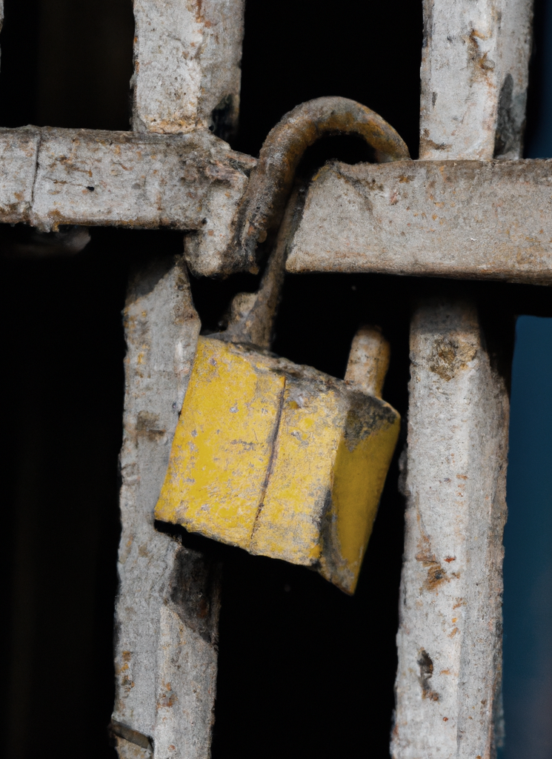
“Ableism is a set of beliefs, processes and practices that produce – based on abilities one exhibits or values –a particular understanding of oneself, one’s body and one’s relationship with others of humanity, other species and the environment, and includes how one is judged by others” (Wolbring 2008).
“Ableism’s psychological, social, economic, cultural character normatively privileges able-bodiesness; promotes smooth form of personhood and smooth health; create space fit for normative citizens; encourages an institutional bias towards autonomous, independent bodies; and lend support to the economic and material dependence on neoliberal and hyper-capitalist form of production” (Goodley, 2014).
Dall-E
Notes:
Approximately 2,000 students are registered with SAS
Students can be registered with permanent and temporary disabilities
The disability must create a functional limitation
Most common disabilities fall under psychological, ADHD, and LD
Most student have more than one area of disabilities

Slide 7
Ableism highlights how many groups have been constructed as lesser
Bodies are medicalized
Identified as “other”
As the object rather than agent of study
For more information see Dolmage, J. (2017). Academic ableism: Disability and higher education. University of Michigan Press. http://www.jstor.org.ezproxy.lib.ucalgary.ca/stable/j.ctvr33d50

Slide 8

Challenging Ableism in the Classroom Through Generative AI
Both Generative AI and Universal Design for learning challenging existing teaching and learning practices
Dall-E

Slide 9
Personalized Education
Focuses on the using machine learning to customize education to performance of a student based on the past performance of other students
Concerns about the applicability of models to address minority learners – resulting in less effective or less beneficial models
Personalized education may result in the students not having full access to curriculum
Universal Design for Learning
Challenges assumptions or gaps in the traditional education practices
Provides opportunity for student choice in accessing materials and demonstrating learning
Learner has full access to the curriculum in multiple structures and modalities
For more information see Holstein & Daroudi (2021) and Nave (2020)

Slide 10
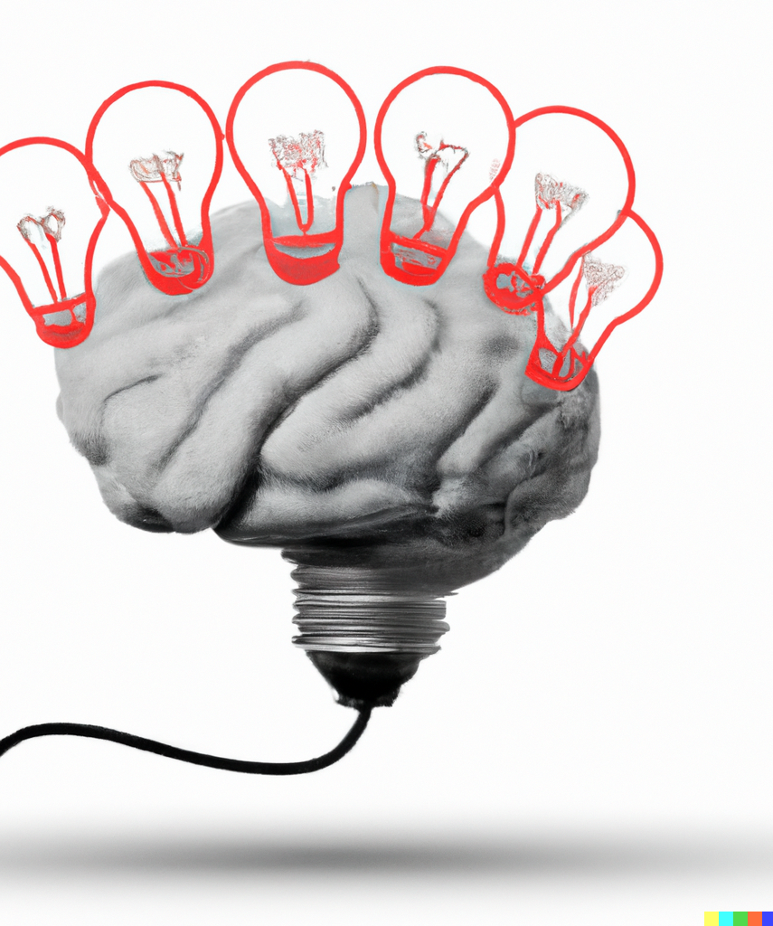
UDL’s Foundational Principles
Engagement (the affective network): Learning engages the affective networks through stimulating interest and motivation
Representation (the recognition network): Learning involves presenting content in different ways and formats
Expression (the strategic network): Learning is demonstrated in a variety of actions and activities
Dall-E
CAST. (n.d.). The UDL Guidelines. https://udlguidelines.cast.org/

Slide 11
The Affective Network
Supporting interested in learning through authentic, relevance teaching practices that reduces distraction
Developing resilience through a goal-oriented approach with variety of resources and feedback
Acknowledging emotions through self-efficacy, coping skills and self-assessment.

Slide 12
The Recognition Network
Providing content in multiple formats that engaged a variety of senses
Decoding content, by creating a shared understanding of language and symbols
Contextualizing content through patterns, structures and background information to promote transfer

Slide 13
The Strategic Network
Designing assessment that allow for multiple means of expressions
Scaffolding assessments by integrating assistive and supporting tools
Supporting planning processes through information management

Slide 14

Integration of UDL into educational contexts is often hampered by perceived additional costs. There are concerns regarding time required from instructors to implement the framework..
Generative AI tools have and will continue to provided ways of supporting UDL, by reducing time required.

Slide 15
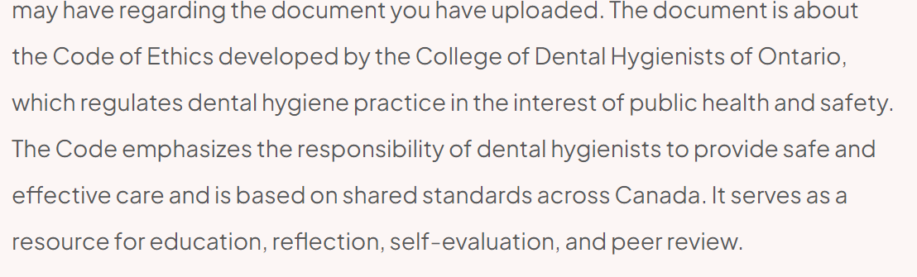
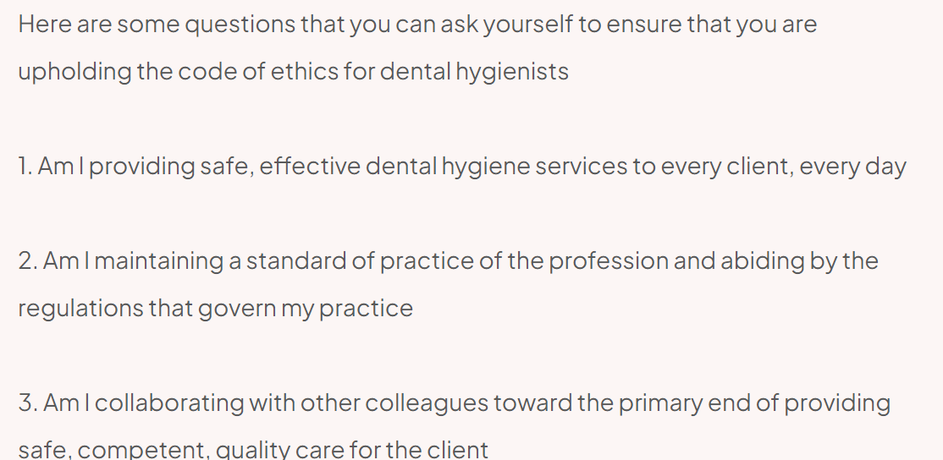
Affective Network
Supporting Engagement
Tool: Ask Your PDF

Slide 16
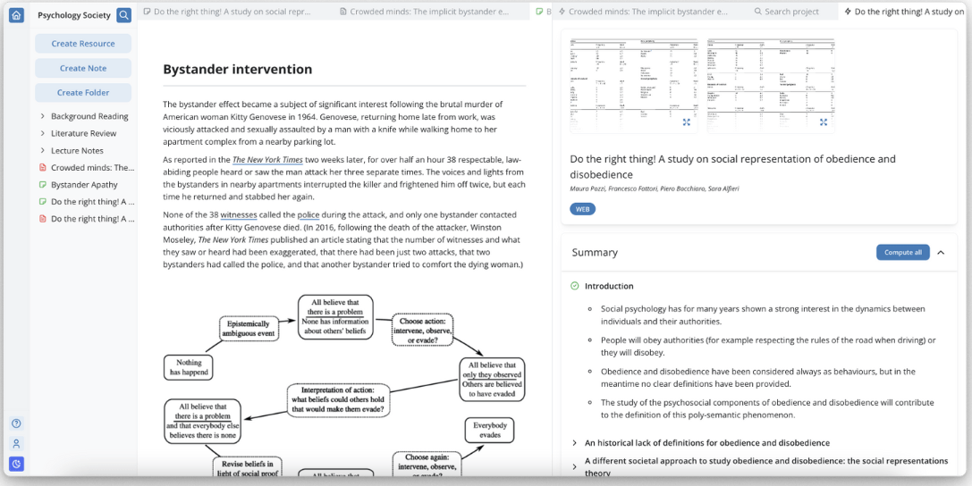
Affective Network
Managing Distractions
Tool: Genei

Slide 17
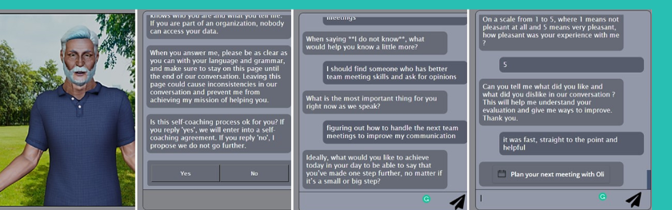
Affective Network
Adapt and Persist
Tool: Pocket Confidant

Slide 18
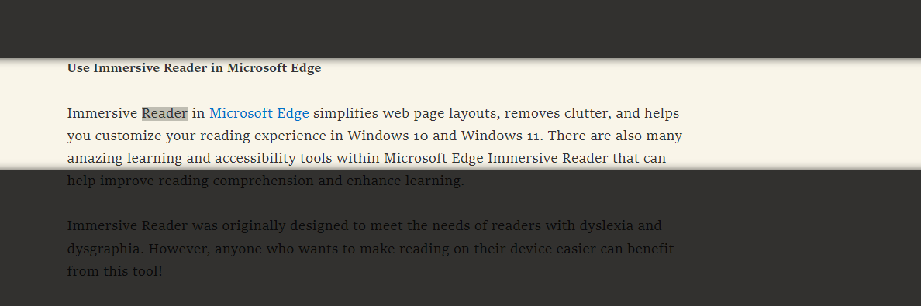
Recognition Network
Multiple Modalities
Tool: Immersive Reader Microsoft Edge

Slide 19
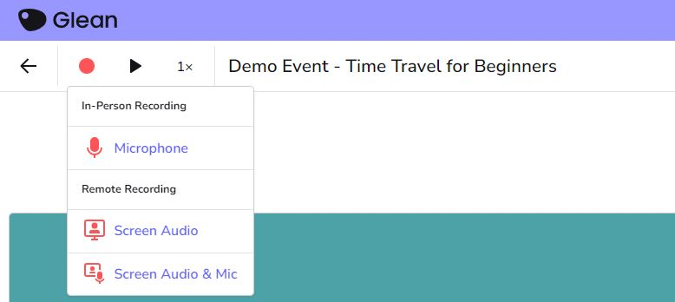
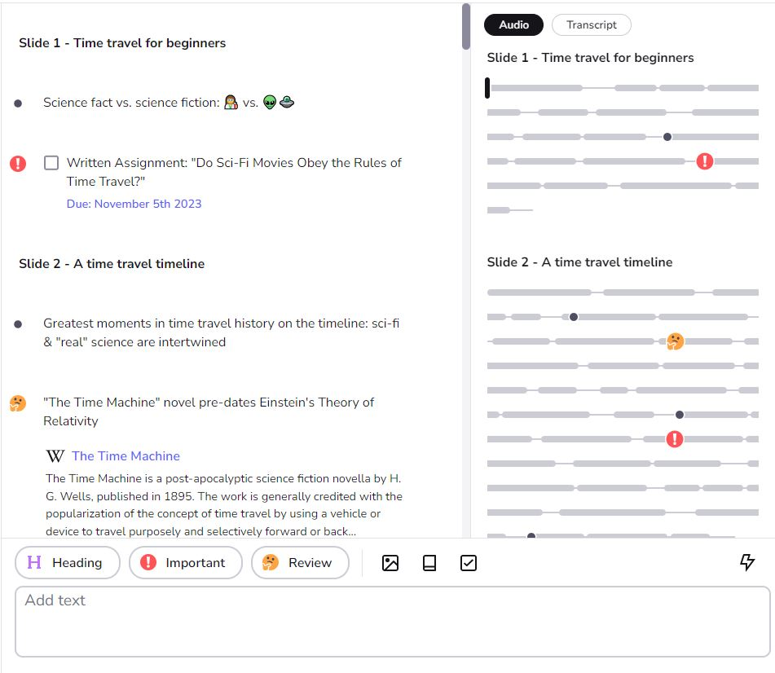
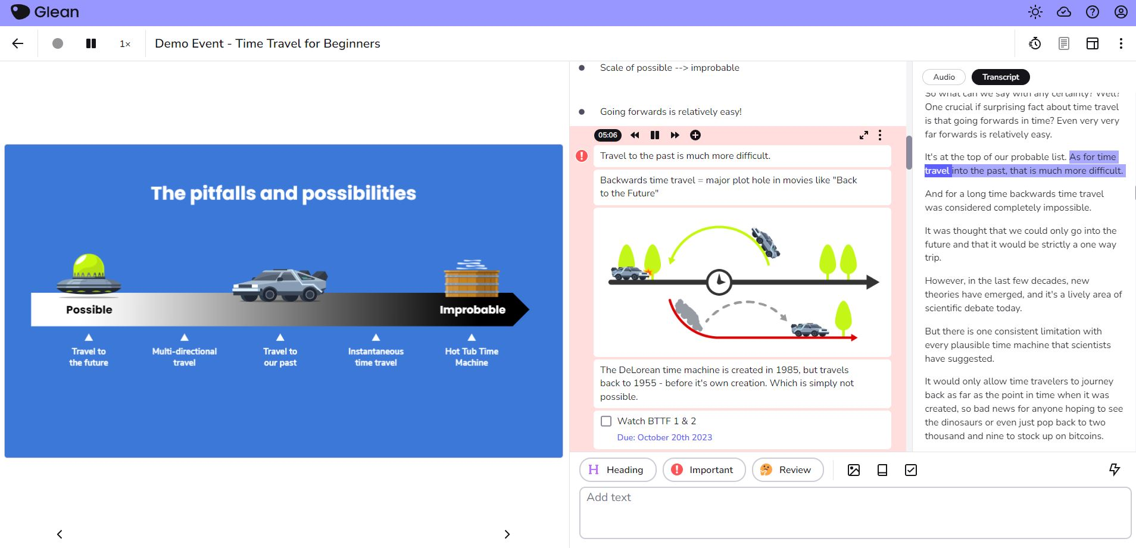
Representation – Cognitive Availability

Slide 20
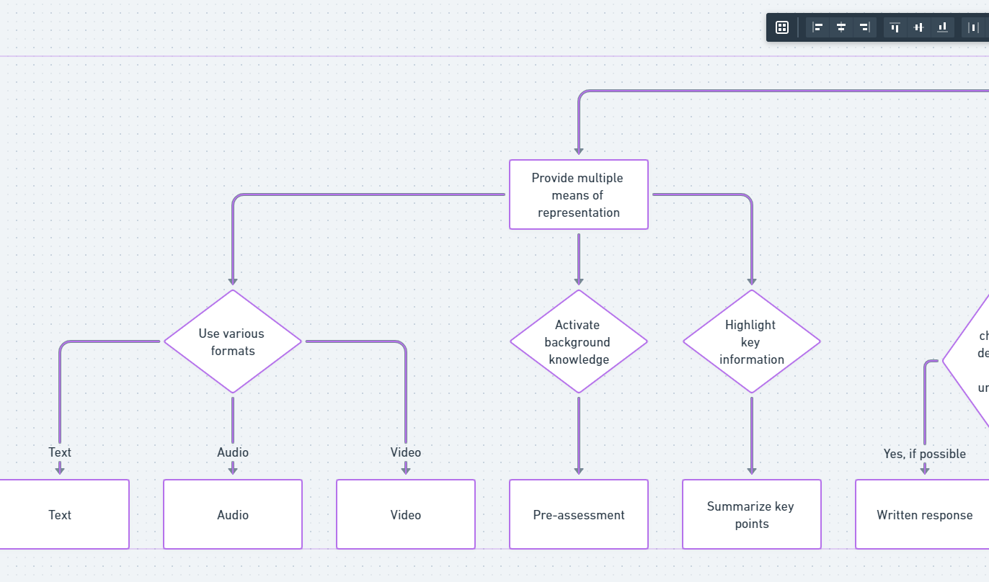
Representation
Mapping Structures
Tool: Whimsical

Slide 21
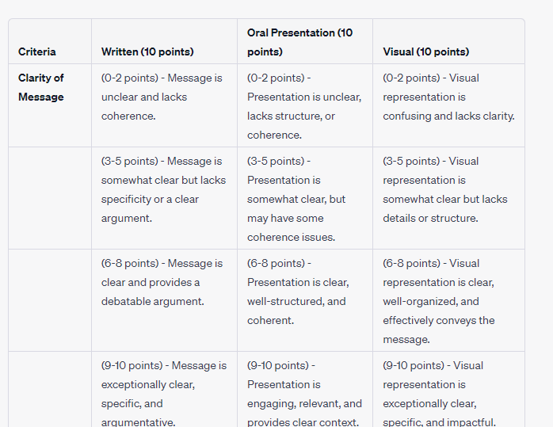
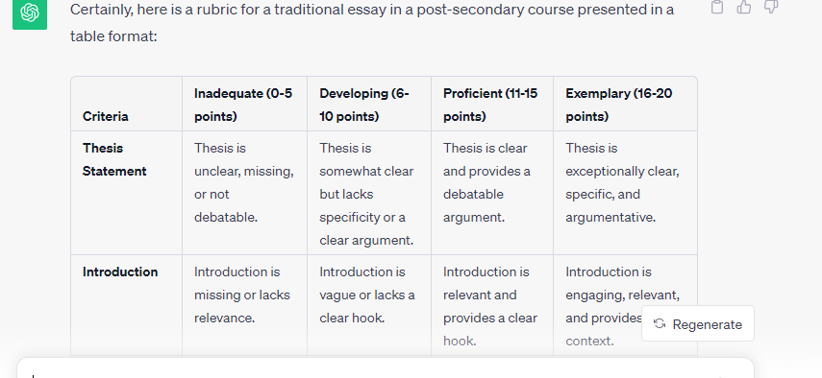
Strategic
Learning Expression
Tool: Chat GPT

Slide 22
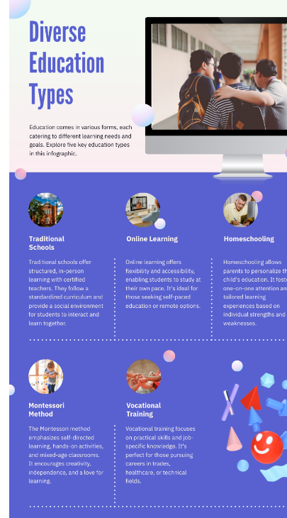
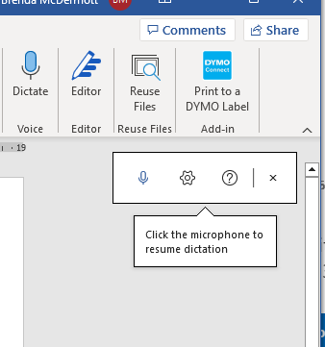
Strategic
Learning Tools
Tool: Word Dictate
Tool: Pictochart

Slide 23
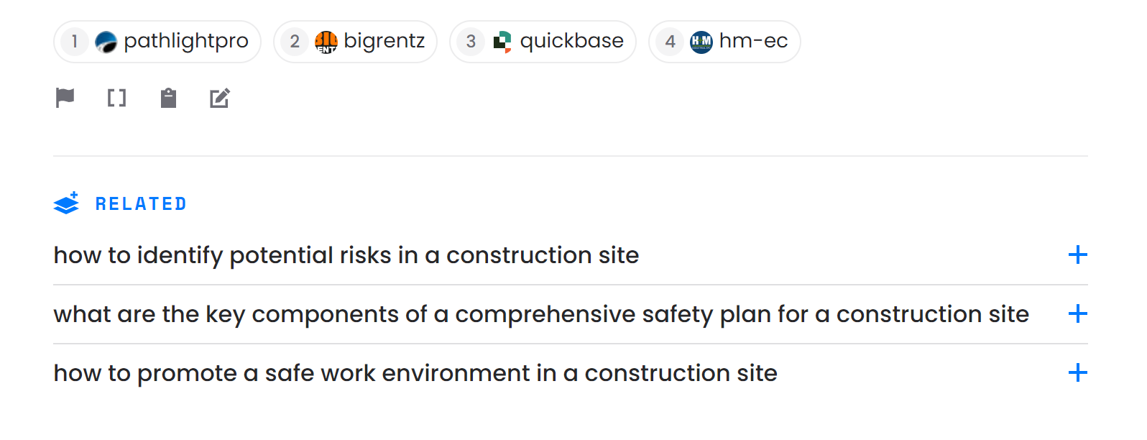
Strategic
Planning
Tool: Perplexity

Slide 24
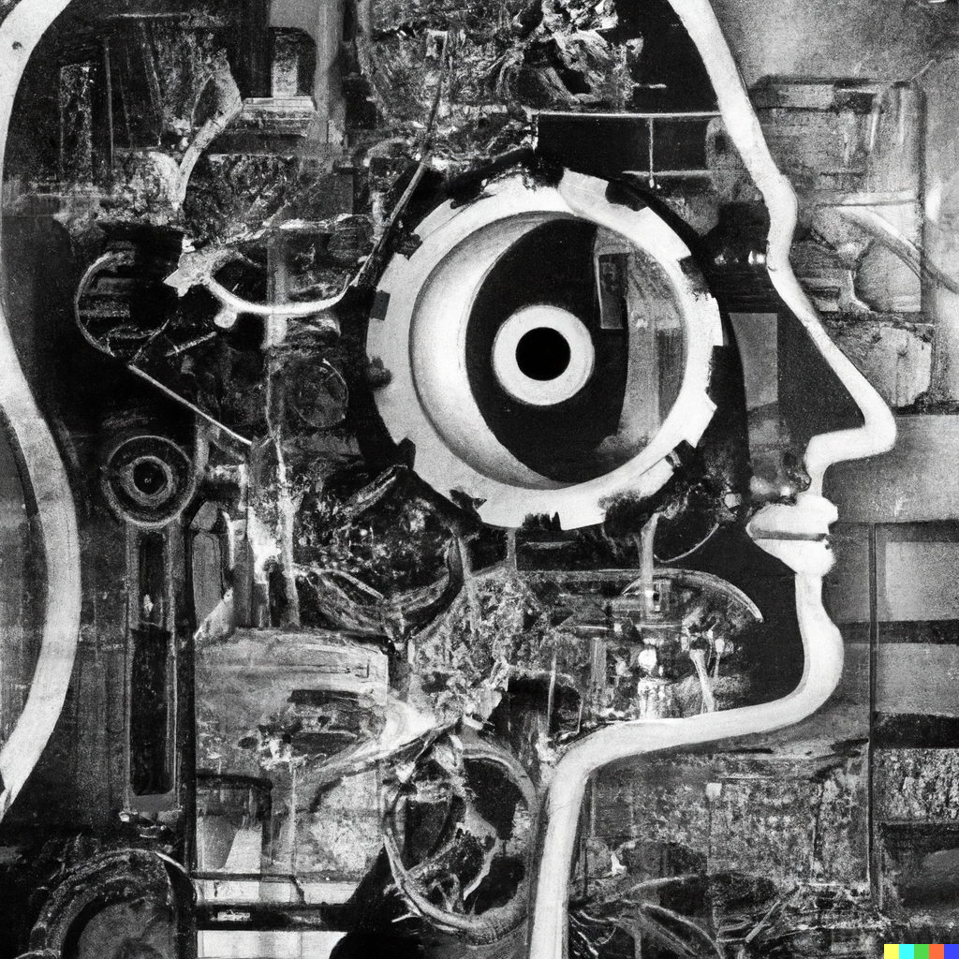
Contextualize fear as a response to challenges to ability bias
Create choice and options for learning, rather than a singular model
Lobby for “AI for Good”, by ensure privacy and equal access
Dall-E

Slide 25
References
Technologies
CAST. (n.d.). The UDL Guidelines. https://udlguidelines.cast.org/
Dolmage, J. (2017). Academic ableism: Disability and higher education. University of Michigan Press. http://www.jstor.org.ezproxy.lib.ucalgary.ca/stable/j.ctvr33d50
Goodley, D. (2014). Dis/ability Studies: Theorizing disablism and ableism. Routledge.
Holstein, K., & Doroudi, S. (2021). Equity and artificial intelligence in education: Will “AIEd” amplify or alleviate inequities in education? https://arxiv.org/abs/2104.12920
McIntyre, N. A. (2023). Access to online learning: Machine learning analysis from a social justice perspective. Education and Information Technologies, 28(4), 3787–3832. https://doi.org/10.1007/s10639-022-11280-5
Nave, L. (2020). UDL in Online Environments: The Why of Learning. Journal of Developmental Education, 44(1), 30–31. https://www.jstor.org/stable/45381107
Weissman, J. (2023, February 9). ChatGPT Is a plague upon education. Inside Higher Ed. https://www.insidehighered.com/views/2023/02/09/chatgpt-plague-upon-education-opinion
Wolbring, G. (2008). The politics of ableism. Development, 51(2), 252–258. https://doi.org/10.1057/dev.2008.17
Genei (2021). Summary Tool. www.genei.io
Open AI (2022). Chat GPT. https://chat.openai.com/
PDF Chatbot (n.d.). Ask your PDF https://askyourpdf.com
Microsoft (n.d.) Edge Immersive Reader. https://www.microsoft.com/en-us/edge?ep=0&es=27&form=MA13FJ
Microsoft (n.d). Word – Dictate. https://www.microsoft.com/en-ca/microsoft-365/word
Perplexity (n.d.). https://www.perplexity.ai/
Picktochart. (2023). AI powered infographic generator. https://piktochart.com/generative-ai/
Pocket Confidant (2020). www.pocketconfidant.com
Whimsical (n.d). www.whimsical.com

